Slide 1

Skin Disease Detection using Convolution Neural Network CS5720 Neural Networks & Deep Learning - Project (CRN: 22317)
Saichandana Gavva ,700748465
Hemanth Lakkimsetti,700747872
P.Sai Hari Chandana,700759721
Gayatri Jagiri,700745729

Slide 2
Role/Responsibilities and Contribution in project
1.Importing libraries and dataset formation:
Importing libraries commonly used in CNN and image processing tasks with TensorFlow and other Python libraries.
IN dataset collection:we have downloaded the pictures from dermnet with five unique infections which are eczema hand, eczema nummular, eczema subcute, lichen simplex chronicus, and stasis dermatitis ano' ulcers
by Saichandana Gavva ,700748465.
2.Image pre-processing and Feature Extraction: Image pre-processing consists of two sub-processes, Contrast Enhancement, and Grayscale Conversion.A raw binary image is converted into the RGB (red/green/blue) Matrix form. The RGB Matrix is first processed for Contrast Enhancement and converted to a contrast-enhanced RGB Matrix, this is done so as to distinguish each pixel from its neighbour. Contrast enhancement is performed using Histogram equalization. The contrast-enhanced RGB Matrix is converted into Grayscale Matrix.
All images are acquired using digital cameras and accompanied by pathology results. The number of features in each image depends on the size of the picture, which can be reduced to a single measure. Shrinking the picture decreases processing time and improves overall performance by Hemanth Lakkimsetti,700747872

Slide 3
3.Proposed Model: In our model, we have 13 layers. We also have 4 convolutional layers, 4 max-pooling layers of size 2*2, two dropouts layer having parameters 0.3 and 0.4,leveled layer and 2 thick layer capacities called 'straight" and 'softmax with image pixels set into 100*100.
Training the Model and Evaluation : For training purposes, we use 80% of our training dataset, and then the rest of the 20% dataset is used for validation purposes. Our training dataset consists of 2400 images. The number of training sets consists of 1920 images and validating set consist of 480 images. Our classifier's batch size 64. 40 epochs were used by us to train the model.
To evaluate the proposed methodology, we have employed standard evaluation measures, precision-recall and F1-score by
P.Sai Hari Chandana,700759721
4.Result Our precession normal, tolerable precession and Recall normal are 70% and F1- score normally is 0.69. Additionally, with the total accuracy of 0.73. Our researchers also have tested on five diseases initially and they have used some core libraries like OpenCV, keras, tensorflow, pandas, numPy, etc. Here we have gained our accuracy over the dataset of about 73% which makes it reliable to use this source of classification to use for the skin disease prediction.
Conclusion:
The proposed method is more accurate than the existing methods for extracting features from skin images and classifying them using a Softmax classifier. The accuracy of 0.87 suggests that this method is highly efficient in detecting and diagnosing skin problems. This work can be helpful for students or researchers in the medical field
by Gayatri Jagiri,700745729

Slide 4
Problem Summary
Skin cancer is one of the top three perilous types of cancer caused by damaged DNA that can cause death.
This damaged DNA begins cells to grow uncontrollably and nowadays it is getting increased speedily.
There exist some researches for the computerized analysis of malignancy in skin lesion images.
However, analysis of these images is very challenging having some troublesome factors like light reflections from the skin surface, variations in color illumination, different shapes, and sizes of the lesions.
As a result, evidential automatic recognition of skin cancer is valuable to build up the accuracy and proficiency of pathologists in the early stages.
In this project, we use a deep convolutional neural network model based on transfer learning approach called DenseNet for the accurate classification between benign and malignant skin lesions.

Slide 5
Progress Summary
Dataset Collection
Image preprocessing
DenseNet Model
Training
Evaluation

Slide 6
Work summary
To avoid the computational cost of training a CNN from scratch, DenseNet-121 pre-trained from ImageNet was used. By training the last dense block and connecting it with three fully connected layers and other optimization techniques the model had a validation accuracy of 93%.
DenseNet-121 was chosen because despite having a depth of 121 layers it is relatively low in parameters compared to other models, and the architecture handles the vanish gradient problem well.

Slide 7
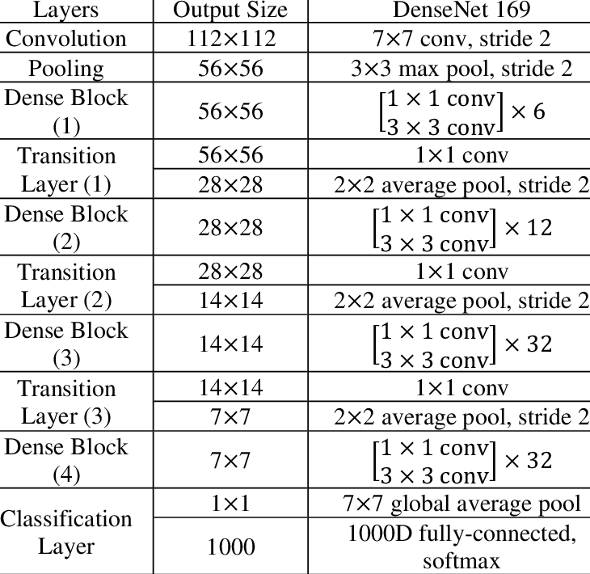
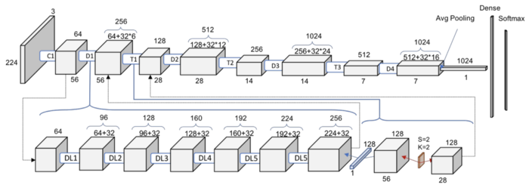
Work summary
DenseNets do not sum the output feature maps of the layer with the incoming feature maps but concatenate them.
DenseBlocks, where the dimensions of the feature maps remains constant within a block, but the number of filters changes between them.
DenseNet-121 Architecture

Slide 8
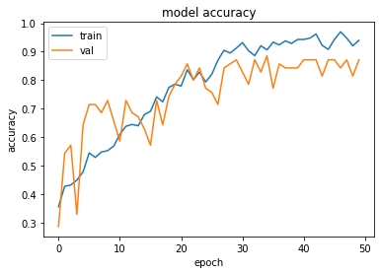
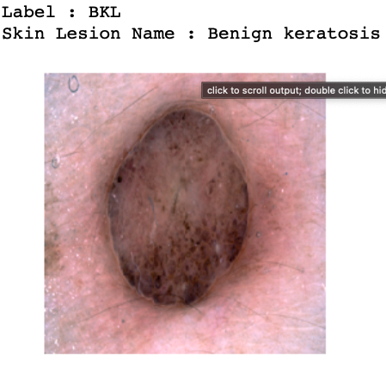
Results summary
The DenseNet model has achieved 93% of accuracy in classifying the lesion melanoma.
With the help of dropouts the. Model can overcome the overfitting issues.

Slide 9
Conclusion & Future work
This study analyzed in-depth technique of DenseNet which is pretrained CNN based model.
It has observed that using deep learning technique DenseNet, there has no dire need for complex and composite pre-processing techniques such as image resize, crop and pixel value normalization.
The DenseNet method showed better results than the other conventional deep learning methods.
With this method we have achieved 93% of accuracy which can easily classify the skin lesion.
In future, the method has to be modified bit more complicated to get more accuracy also we can change the optimizer.

Slide 10
References:
[1]. Goceri, E. (2019). Skin disease diagnosis from photographs using deep learning. In VipIMAGE 2019: Proceedings of the VII ECCOMAS Thematic Conference on Computational Vision and Medical Image Processing, October 16–18, 2019, Porto, Portugal (pp. 239-246). Springer International Publishing.
[2]. Li, H., Pan, Y., Zhao, J., & Zhang, L. (2021). Skin disease diagnosis with deep learning: a review. Neurocomputing, 464, 364-393.
[3]. Inthiyaz, S., Altahan, B. R., Ahammad, S. H., Rajesh, V., Kalangi, R. R., Smirani, L. K., ... & Rashed, A. N. Z. (2023). Skin disease detection using deep learning. Advances in Engineering Software, 175, 103361.
[4]. Li, L. F., Wang, X., Hu, W. J., Xiong, N. N., Du, Y. X., & Li, B. S. (2020).
Deep learning in skin disease image recognition: A review. IEEE Access, 8, 208264-208280.
[5]. Kumar, V. B., Kumar, S. S., & Saboo, V. (2016, September). Dermatological disease detection using image processing and machine learning. In 2016 Third
International Conference on Artificial Intelligence and Pattern Recognition (AIPR)
(pp. 1-6). IEEE.
[6]. Anand, V., Gupta, S., & Koundal, D. (2022). Skin disease diagnosis: challenges and opportunities. In Proceedings of Second Doctoral Symposium on Computational Intelligence: DoSCI 2021 (pp. 449-459). Springer Singapore.
[7]. Rathod, J., Waghmode, V., Sodha, A., & Bhavathankar, P. (2018, March). Diagnosis of skin diseases using Convolutional Neural Networks. In 2018 second international conference on electronics, communication and aerospace technology (ICECA) (pp. 1048-1051). IEEE.
[8]. Rimi, T. A., Sultana, N., & Foysal, M. F. A. (2020, May). Derm-NN: skin diseases detection using convolutional neural network. In 2020 4th International Conference on Intelligent Computing and Control Systems (ICICCS) (pp. 1205-1209). IEEE.

Slide 11
Thank you

